Slide 1
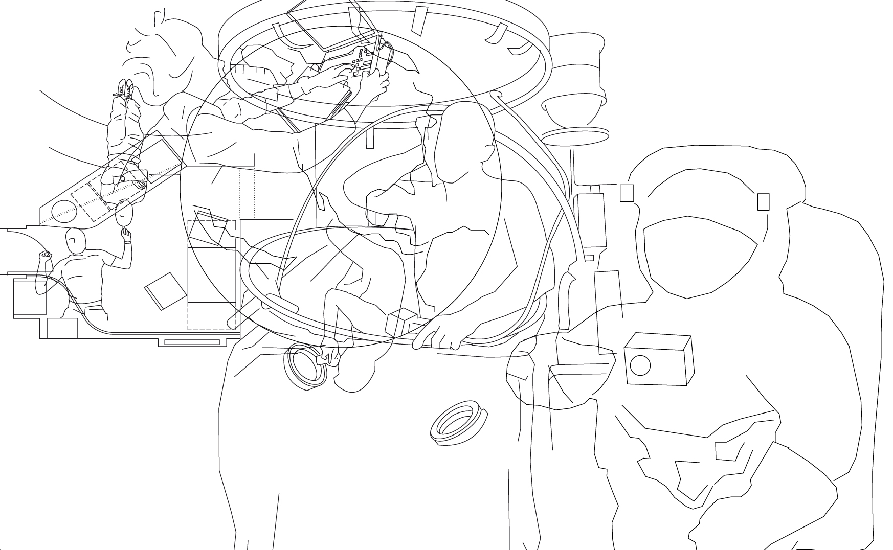
EDUCATING SPACE ARCHITECTS & MOONBASE DESIGNERS
Vienna University of Technology 2012-2020
Dr.Ing. Sandra Häuplik-Meusburger | TU Vienna | space-craft Architektur
.

Slide 2
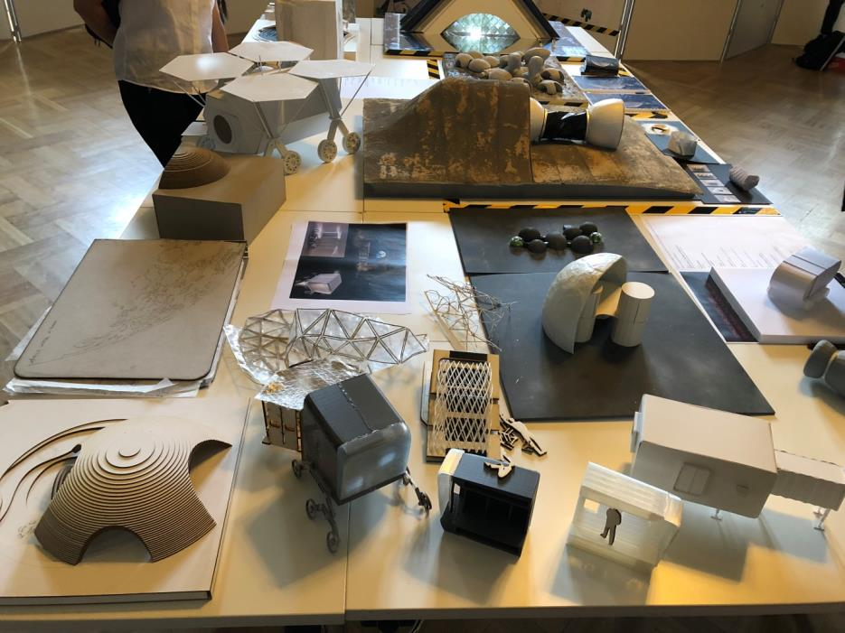
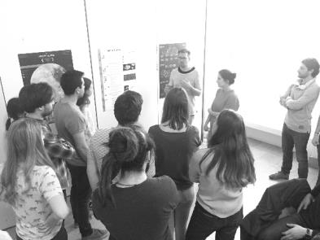
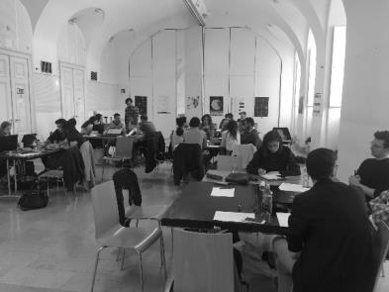
TU Wien
Institute for Architecture and Design
Department Building Construction and Design
.

Slide 3
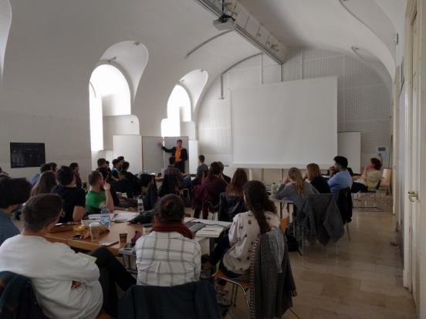
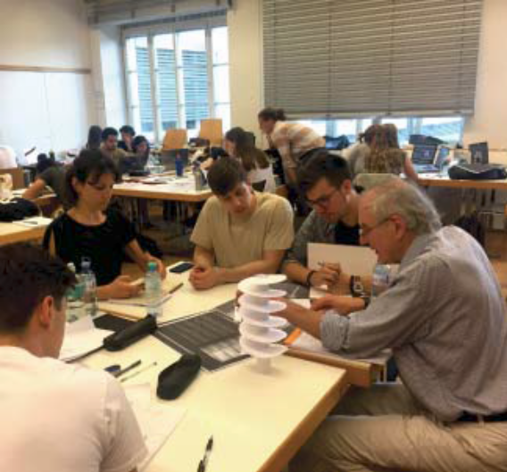
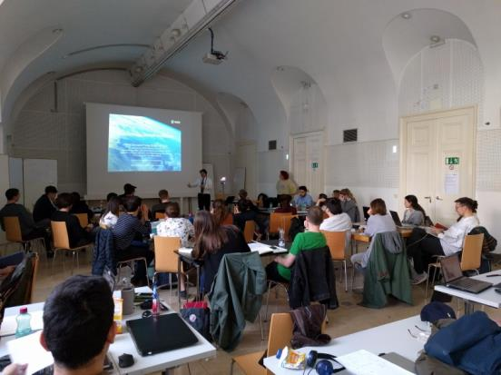
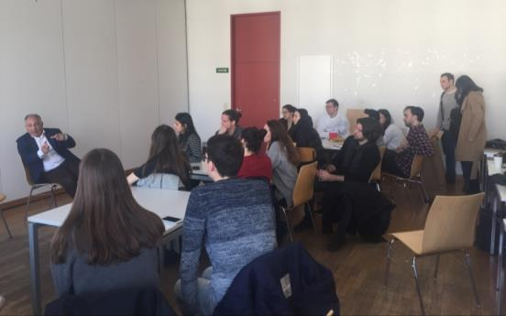
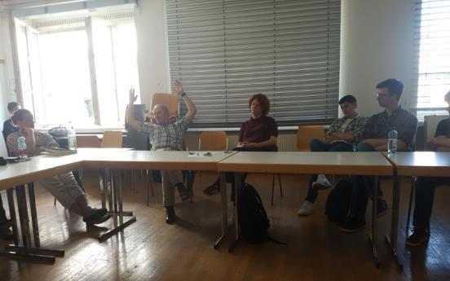
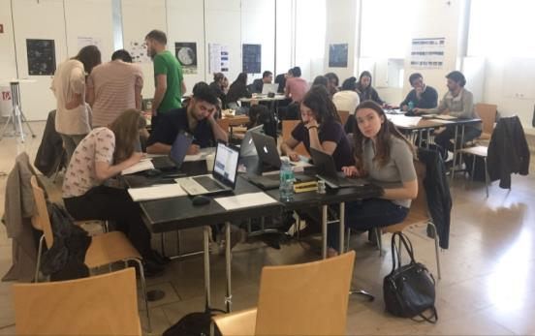
Analysis – Research – Input Lectures – Workshops- Integration
.

Slide 4
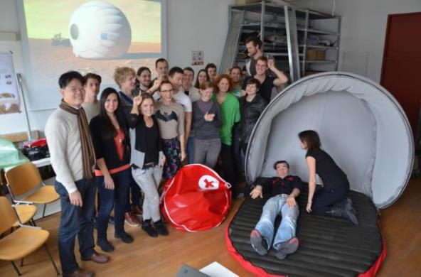
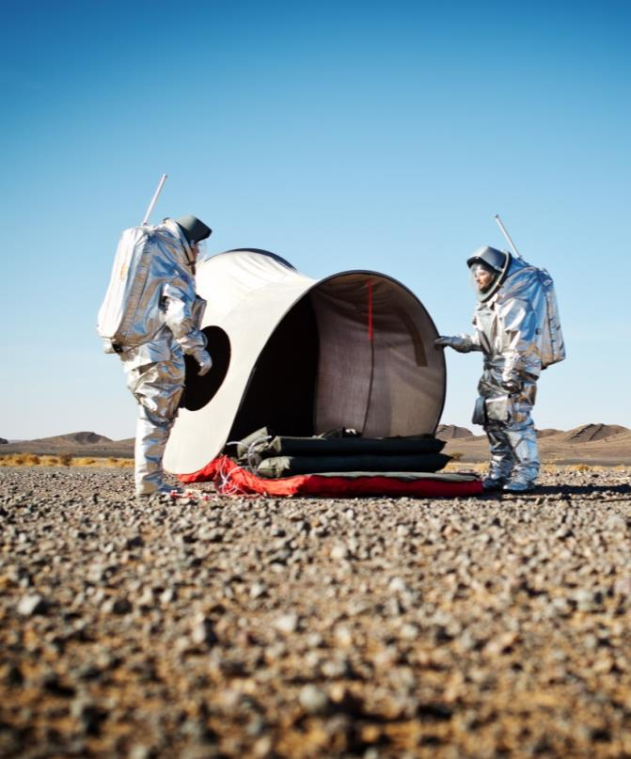
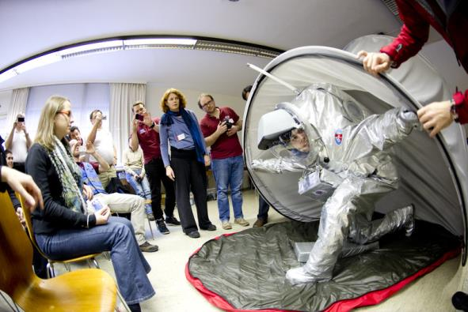
Prototype Development and Testing
.
.
Austrian Space Forum, Mars Marokko Analog Simulation Mission, Fotos: u.a. ÖWF, Katja Zanella Kux

Slide 5


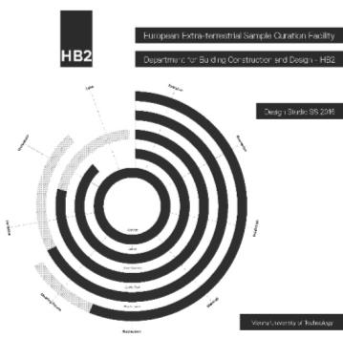

Design Studios at the TU Vienna:
Space Architecture Program
.
Online Publications:
http://issuu.com/hochbau2/docs
.

Slide 6
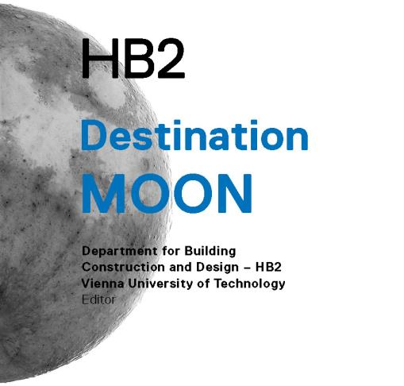
Design Studio:
Destination Moon
.
.
http://issuu.com/hochbau2/docs

Slide 7
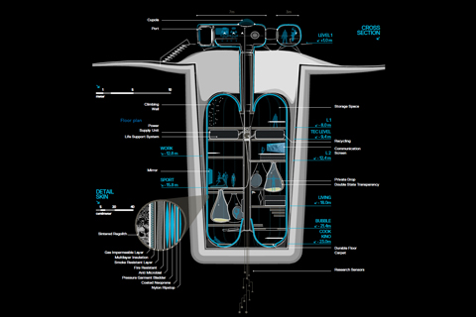
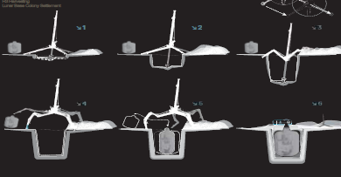
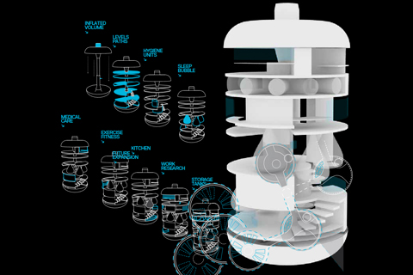
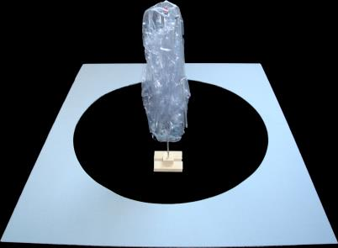
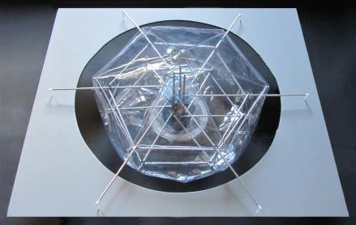
Design Studio:
Destination Moon
.
Project Down to Earth by Amine Khouni and Kerstin Pluch, 2012
Deployable model by Kristoffer Stefan, 2012
.

Slide 8
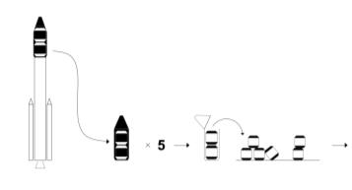
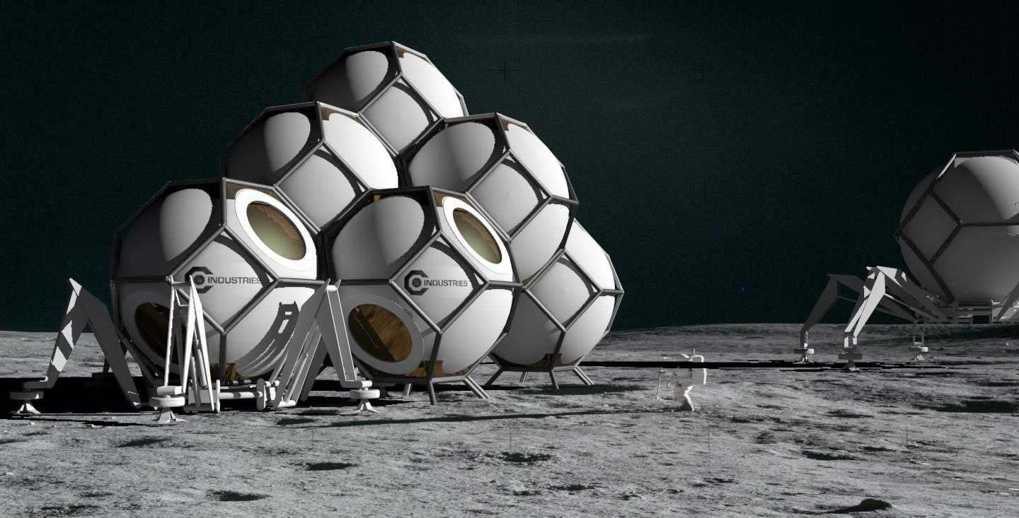
Design Studio:Destination Moon
CyclopsHUB
.
Project by Ottokar Benesch, Daniel Galonja, Thomas Milchram and Vittorio Rossetti, 2012
.

Slide 9
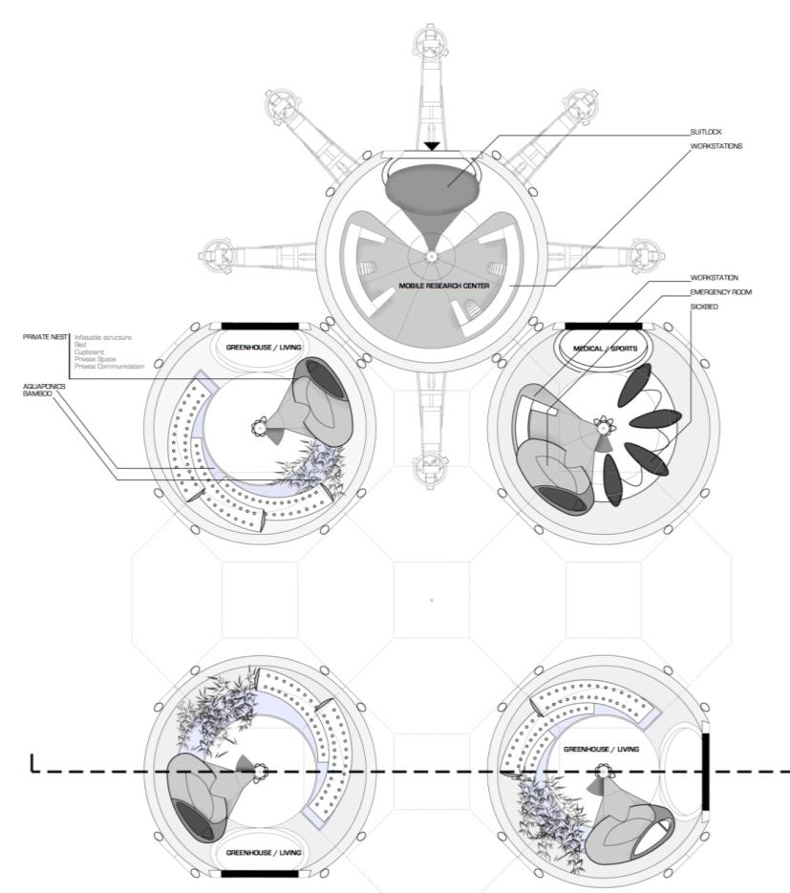
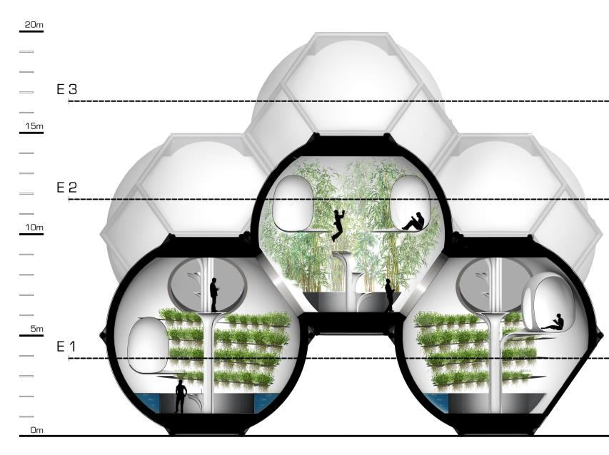
Design Studio:Destination Moon
CyclopsHUB
.
Project by Ottokar Benesch, Daniel Galonja, Thomas Milchram and Vittorio Rossetti, 2012
.

Slide 10
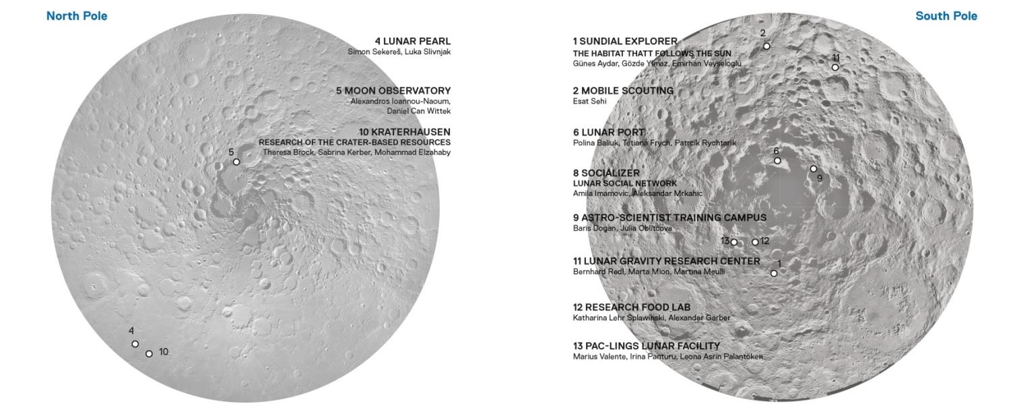
Design Studio:
Moon Village
.
.

Slide 11


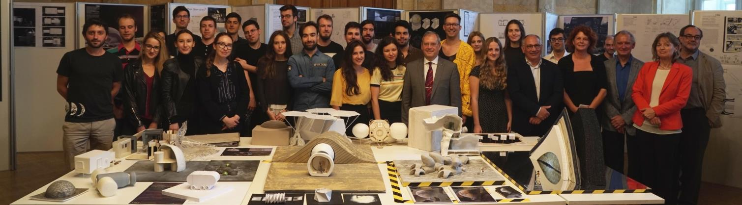
Design Studio: Moon Village
Guest Lectureres / Instructors: Manuela Aguzzi (Space Application Services), Marlies Arnhof (ESA YGT / TU Wien), Miriam Dall’Igna (Foster + Partners), Norbert Frischauf (OffWorld), Bernard H. Foing (ESA). Gernot Groemer (OEWF), David Kendall (ISU), Franz Kerschbaum (Uni Wien), Christian Köberl (NHM, Uni Wien), Christophe Lasseur (ESA), Irmgard Marboe (Uni Wien), Piero Messina (ESA HQ, Strategies Department), Rumi Nakamuri (OEAW), David Nixon (Astrocourier), Dorin Prunariu (cosmonaut, ASE), Franz Viehböck (former cosmonaut, Austria).
Students: Aydar Günes, Baliuk Polina, Brock Theresa, Dogan Baris, Drageljevic Nadja, Elzahaby Mohammad, Esat Sehi, Frych Tetiana, Garber Alexander, Hofer Mathias, Imamovic Amila, Ioannou-Naoum Alexandros, Lehr-Splawinski Katharina, Kerber Sabrina, Klug Daniel, Koncar-Gamulin Lovro, Krhen Domagoj, Meulli Martina, Mion Marta, Mrkajic Aleksandar, Oblitcova Iulia, Palantöken Leona Asrin, Panturu Irina, Redl Bernhard, Rychtarik Patrick, Sekere Simon, Slivnjak Luka, Valente Marius, Veyseloglu Emirhan, Wittek Daniel Can, Yilmaz Gözde.
.
.

Slide 12
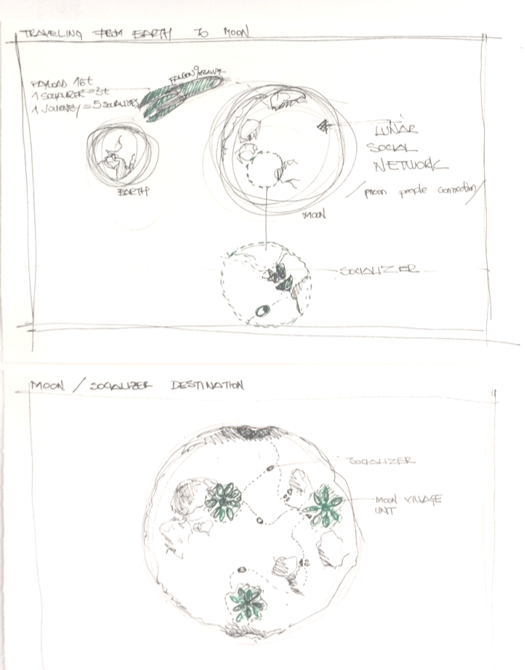
New themes for a MoonVILLAGE
How can we sustainably live and work
together in a multi-cultural society ?

Slide 13
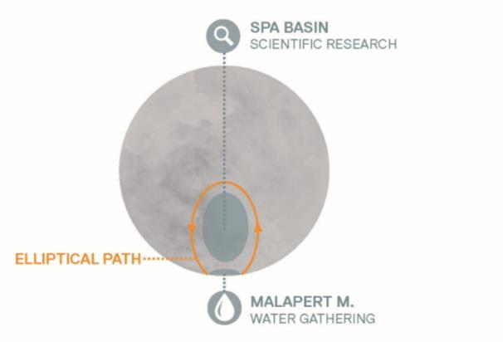
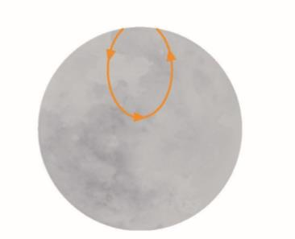
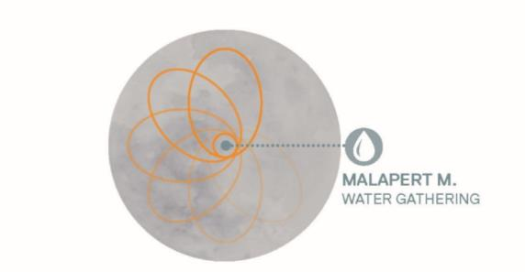
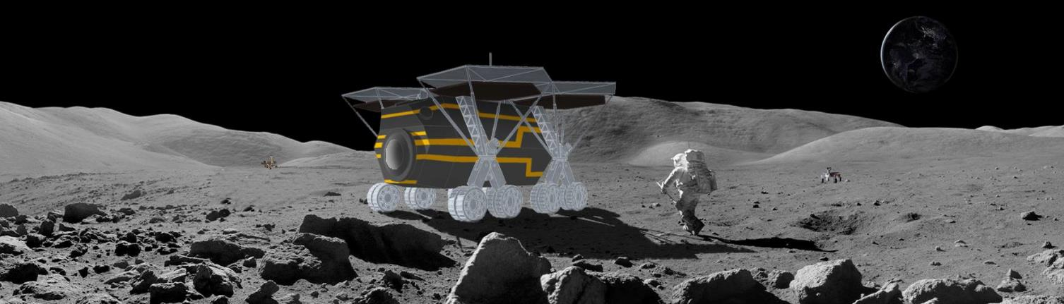
Design Studio: Moon Village
Sundial Explorer
Project by Günes Aydar, Emirhan Veyseloglu, and GözdeYilmaz, 2018

Slide 14
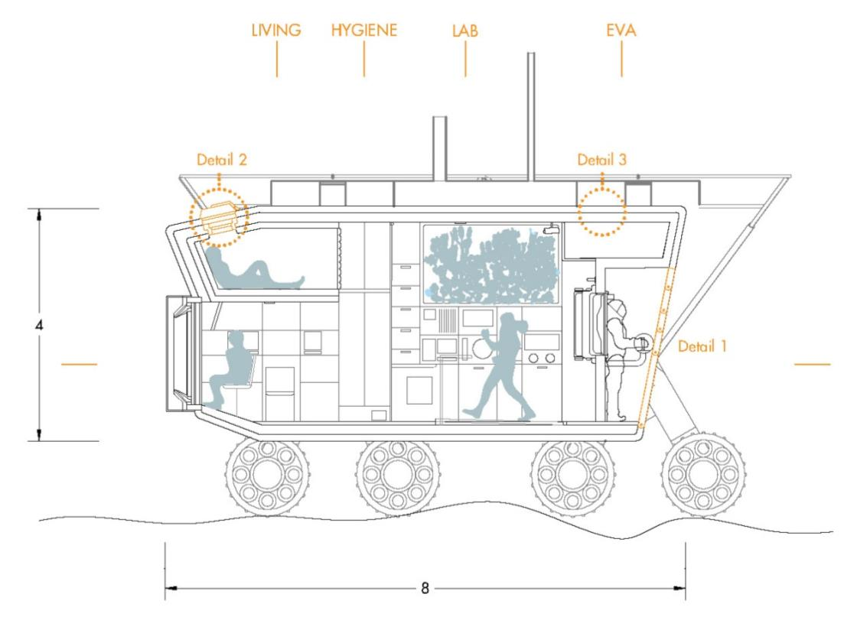
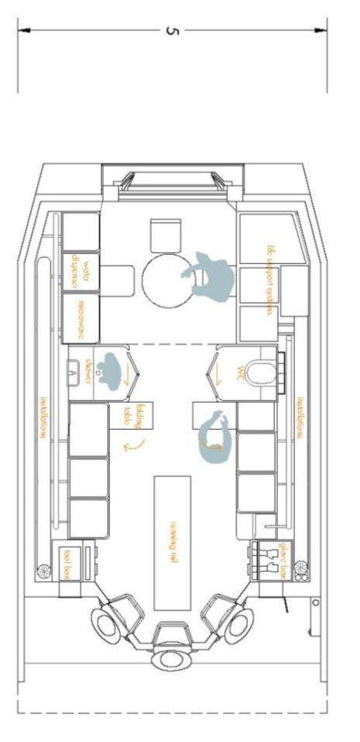
Design Studio: Moon Village
Sundial Explorer
Project by Günes Aydar, Emirhan Veyseloglu, and GözdeYilmaz, 2018

Slide 15
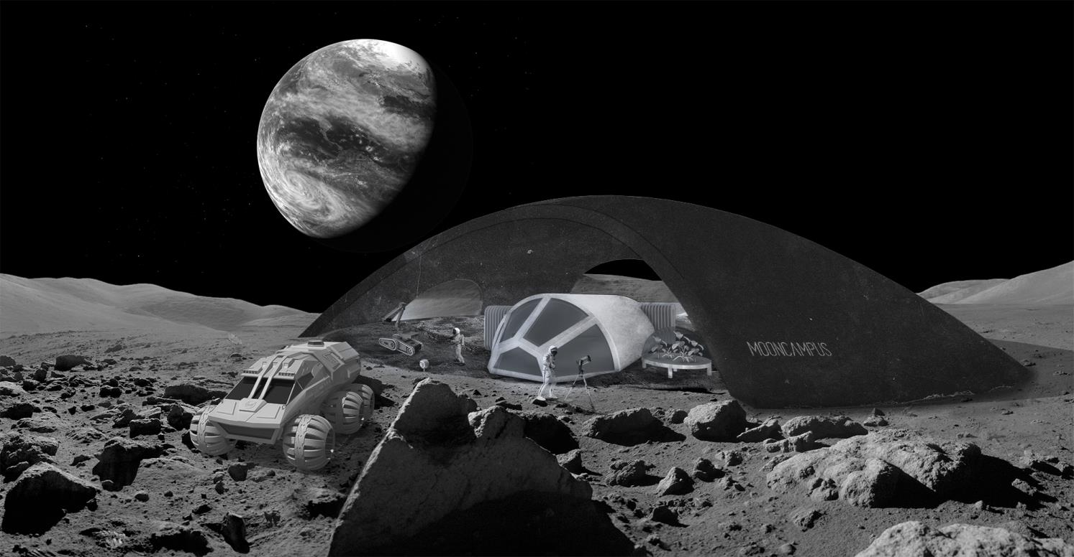
Design Studio: Moon Village
Training Campus on the Moon
Project by Baris Dogan and Julia Oblitcova, 2018

Slide 16
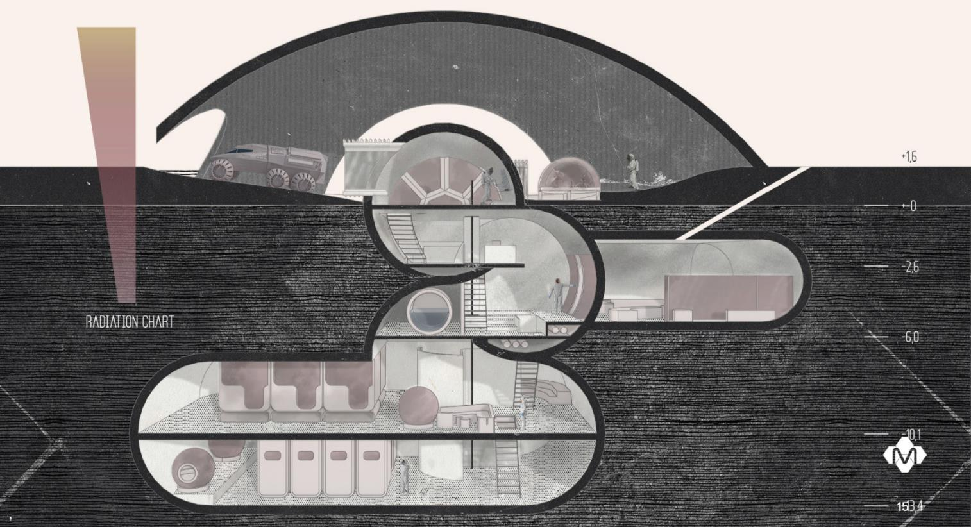
Design Studio: Moon Village
Training Campus on the Moon
Project by Baris Dogan and Julia Oblitcova, 2018

Slide 17

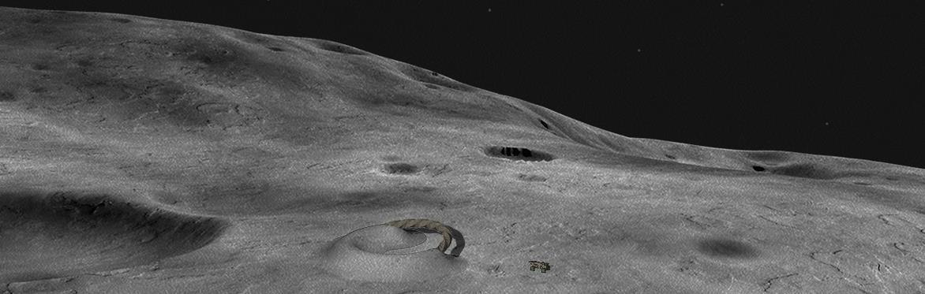
Design Studio: Moon Village
Tube of Eden
Project by Alexander Garber and Katharina Lehr Splawinski, 2018

Slide 18
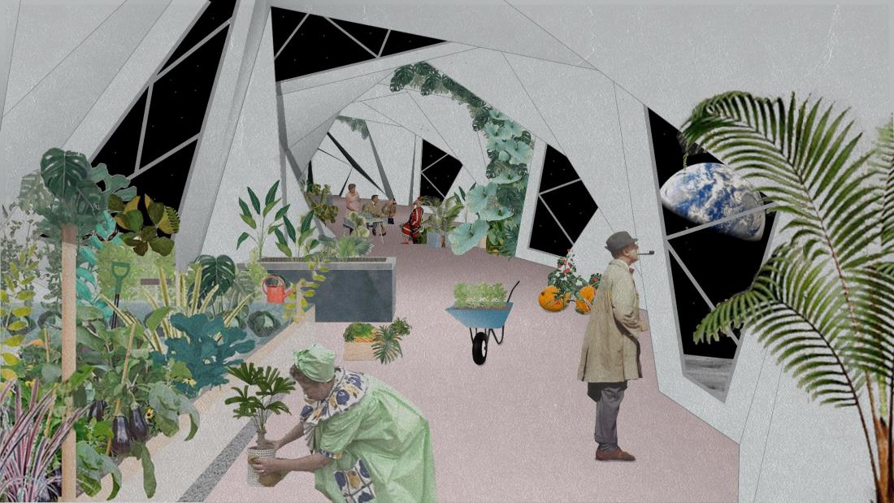
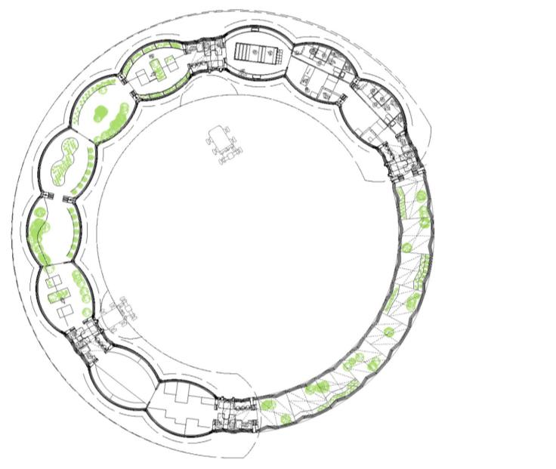
Design Studio: Moon Village
Tube of Eden
Project by Alexander Garber and Katharina Lehr Splawinski, 2018

Slide 19


Design Studio: Moon Village
PAC-lings
Top view of the recycling facility and its infrastructure. (credit: HB2, TU Wien, Design Studio Moon Village, Palatöken, Panturu, Valente, 2018)

Slide 20
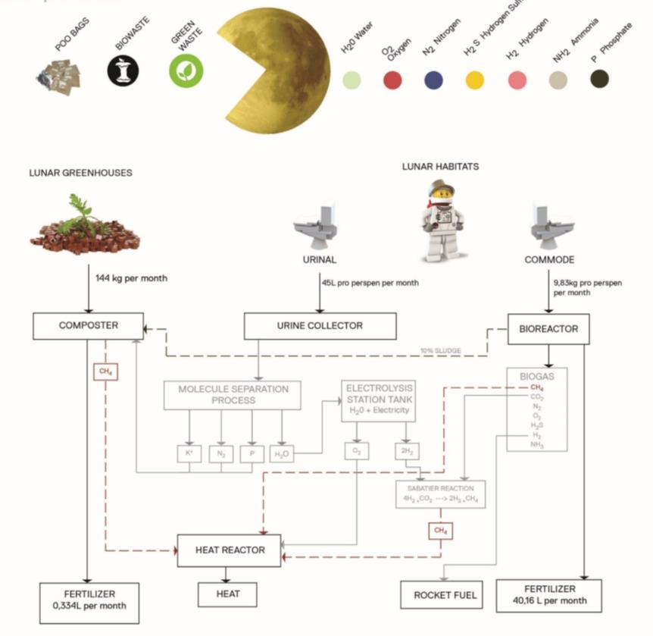
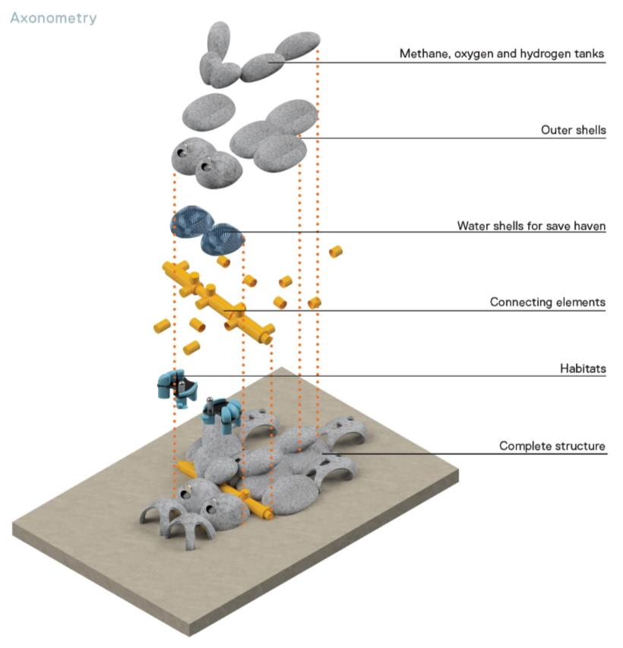
Design Studio: Moon Village -PAC-lings
Top view of the recycling facility and its infrastructure. (credit: HB2, TU Wien, Design Studio Moon Village, Palatöken, Panturu, Valente, 2018)

Slide 21
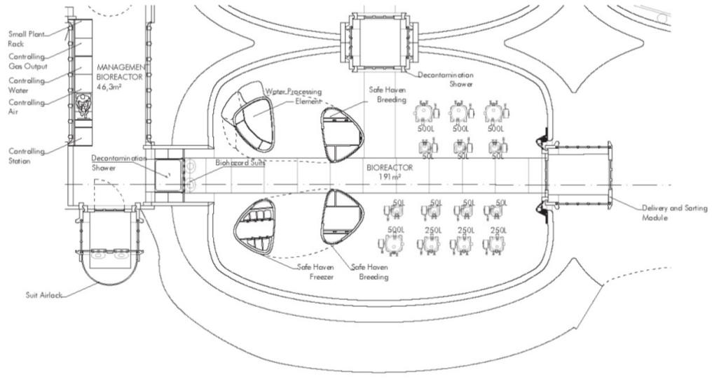
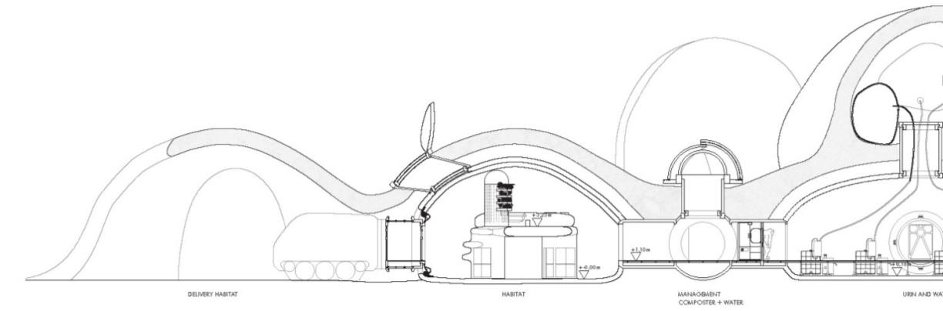
Design Studio: Moon Village
PAC-lings
Top view of the recycling facility and its infrastructure. (credit: HB2, TU Wien, Design Studio Moon Village, Palatöken, Panturu, Valente, 2018)

Slide 22
Thank you!
Online Publications:
http://issuu.com/hochbau2/docs
Questions:
haeuplik@hb2.tuwien.ac.at

